Slide 1

RV College of Engineering
Go, change the world
UNIT-I
Algorithm and Flowchart

Slide 2

Algorithm
RV College of Engineering
Go, change the world
Definition
In programming, algorithm is a set of well defined instructions in sequence to solve the problem.
Qualities of a good algorithm
□Input and output should be defined precisely.
□Each steps in algorithm should be clear and unambiguous.
□Algorithm should be most effective among many different ways to solve a problem.
□An algorithm shouldn’t have computer code. Instead, the algorithm should be written in such way that, it can be used in similar programming languages.

Slide 3
Algorithm -Example
RV College of Engineering
Go, change the world
Write an algorithm to add two numbers entered by user.
Step 1: Start
Step 2: Declare variables num1, num2 and sum.
Step 3: Read values num1 and num2.
Step 4: Add num1 and num2 and assign the result to sum. sum←num1+num2
Step 5: Display sum
Step 6: Stop

Slide 4
Algorithm –Example 2
RV College of Engineering
Go, change the world
Write an algorithm to find the largest among three different numbers entered by user.
Step 1: Start
Step 2: Declare variables a,b and c.
Step 3: Read variables a,b and c.
Step 4: If a>b If a>c Display a is the largest number.
Else Display c is the largest number.
Else If b>c Display b is the largest number.
Else Display c is the greatest number.
Step 5: Stop

Slide 5
Advantages of Algorithm
RV College of Engineering
Go, change the world
□ It is a step-wise representation of a solution to a given problem, which makes it easy to understand.
□An algorithm uses a definite procedure.
□It is not dependent on any programming language, so it is easy to understand for anyone even without programming knowledge.
□Every step in an algorithm has its own logical sequence so it is easy to debug.
□By using algorithm, the problem is broken down into smaller pieces or steps hence, it is easier for programmer to convert it into an actual program

Slide 6
Disadvantages of Algorithm
RV College of Engineering
Go, change the world
□ Writing algorithm takes a long time.
□An Algorithm is not a computer program, it is rather a concept of how a program should be.

Slide 7
Flowchart
A flowchart is a type of diagram that represents an algorithm, workflow or process.
The flowchart shows the steps as boxes of various kinds, and their order by connecting the boxes with arrows. …
Flowcharts are used in analyzing, designing, documenting or managing a process or program in various fields.
It is not necessary that There should be certain set standards on the amount of details that should be provided in a flowchart
The process of drawing the flowchart for the given algorithm is called “Flow Charting”
:In computer science, flowchart refers to a pictorial representation of an algorithm.
Detailed Flow Chart is called : MICRO Flowchart
A flowchart that outlines the main segments of a program : MACRO Flowchart
RV College of Engineering
Go, change the world

Slide 8
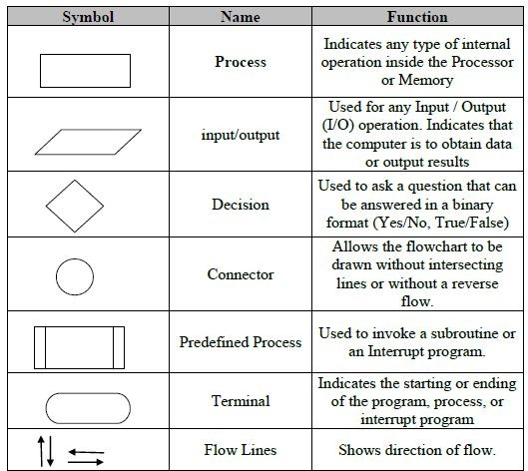
Flowchart
RV College of Engineering
Go, change the world

Slide 9
Advantages of Flowchart
RV College of Engineering
Go, change the world
□The Flowchart is an excellent way of communicating the logic of a program.
□It is easy and efficient to analyze problem using flowchart.
□During program development cycle, the flowchart plays the role of a guide or a blueprint. Which makes program development process easier.
□After successful development of a program, it needs continuous timely maintenance during the course of its operation. The flowchart makes program or system maintenance easier.
□It helps the programmer to write the program code.
□It is easy to convert the flowchart into any programming language code as it does not use any specific programming language concept.

Slide 10
Disadvantages of Flowchart
RV College of Engineering
Go, change the world
□The flowchart can be complex when the logic of a program is quite complicated.
□Drawing flowchart is a time-consuming task.
□Difficult to alter the flowchart. Sometimes, the designer needs to redraw the complete flowchart to change the logic of the flowchart or to alter the flowchart.
□Since it uses special sets of symbols for every action, it is quite a tedious task to develop a flowchart as it requires special tools to draw the necessary symbols.
□In the case of a complex flowchart, other programmers might have a difficult time understanding the logic and process of the flowchart.
□It is just a visualization of a program, it cannot function like an actual program

Slide 11
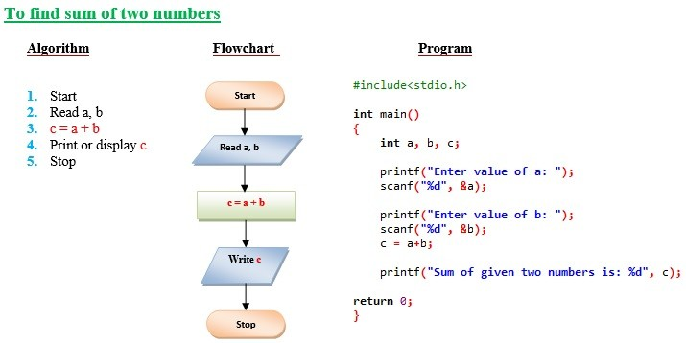
Example
RV College of Engineering
Go, change the world

Slide 12
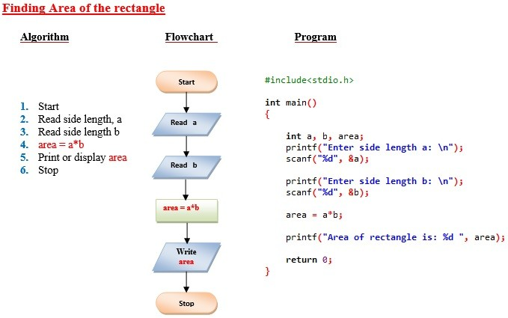
Example
RV College of Engineering
Go, change the world

Slide 13
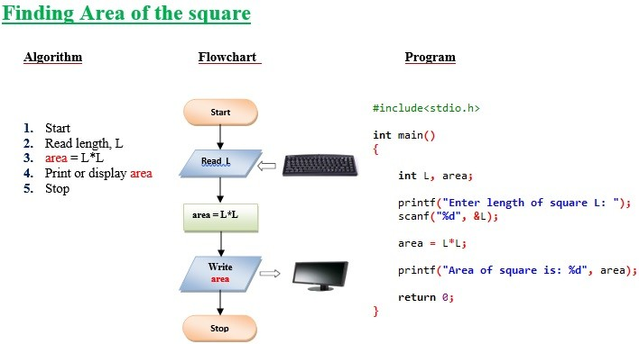
Example
RV College of Engineering
Go, change the world

Slide 14
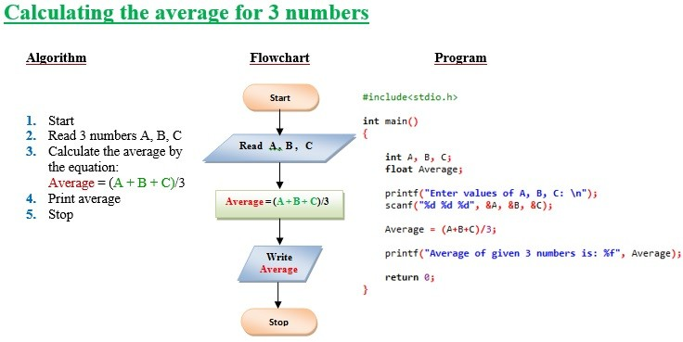
Example
RV College of Engineering
Go, change the world

Slide 15
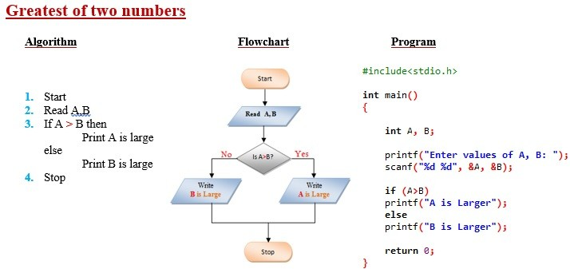
Example
RV College of Engineering
Go, change the world

Slide 16
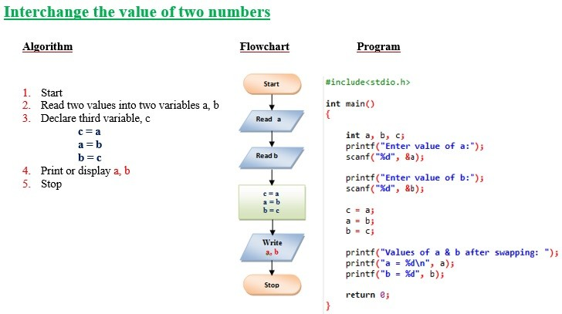
Example
RV College of Engineering
Go, change the world

Slide 17
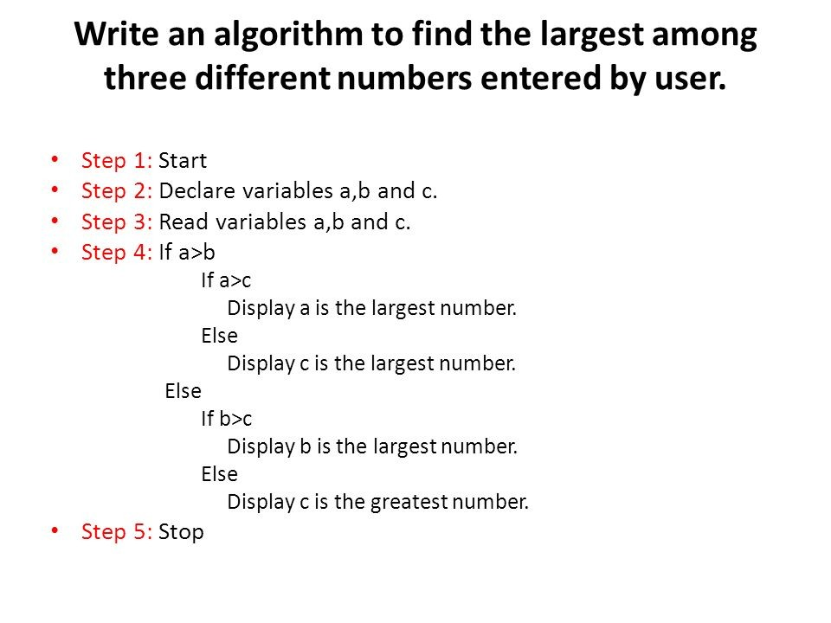
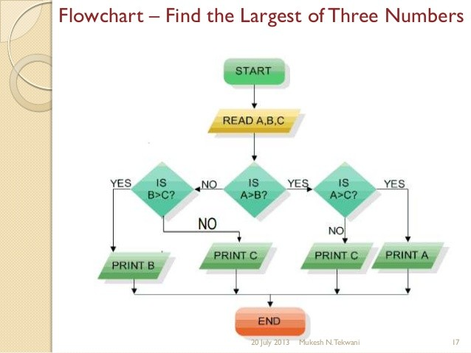
Example
RV College of Engineering
Go, change the world

